Slide 1
The Data Analytics Life Cycle
Course: – D204 - The Data Analytics Journey
Series 1

Slide 2

D204 -The Data Analytics Journey
The Data Analytics Journey gives an overview of the entire analytics life cycle. You will gain fluency in data analytics terminology, tools, and techniques.
The course contextualizes the data analytics journey firmly with organizational metrics and requirements to position graduates to answer key questions for businesses and other employers. This course has no prerequisites.

Slide 3

Course Outline
S1. Data Analytics Life Cycle
S2. DA Tools and Techniques
S3. Organizational Needs
S4. Ethical and Legal Issues
A5. Project Planning/Teamwork & Collaboration

Slide 4
Exams Pre-A 60 questions, 120 minutes OA-60 questions, 120 minutes
1. Competency 4030.2.1: The Data Analytics Life Cycle 30%
2. Competency 4030.2.4: Data Analytics Tools & Techniques 25%
3. Competency 4030.2.3: Organizational Needs 25%
4. Competency 4030.2.2: Project Planning 20%

Slide 5
A2: The Data Analytics Life Cycle
Data Analytics Life cycle | Tools and Techniques | Potential Problems | Data Pathway Terms (4 Phases) | Data Science (6 Phases)
Business Understanding/ Discovery phase An analyst defines the business requirements, and the major questions of interest, determines the needs of the stakeholders, and assesses the resource constraints of the project. Defines the project outcomes. | Tools: Scope Statement Stakeholder Register Gannt Chart Network Diagram Techniques: Critical Path Method KPI Budget estimation techniques Schedule estimation techniques. SWOT Analysis | Lack of clear focus on: Stakeholders, Timeline, Limitations, and Budget could potentially derail an analysis. | 1.Planning: Define goals. Organize resources (software, hardware, staff) Coordinate people Schedule the project | Find a question
Notes:
Candidates should identify a research question that summarizes a realistic problem that aligns with the dataset and can be informed by completing a Principal Component Analysis.

Slide 6
A2 cont’d: The Data Analytics Life Cycle
Data Analytics Life cycle | Tools and Techniques | Potential Problems | Data Pathway Terms (4 Phases) | Data Science (6 Phases)
Data Acquisition: Collecting data phase. Data is collected and stored, for easy retrieval from a database, perhaps a component of a data warehouse, using a language like SQL. Web scraping software and surveys are also used to acquire the data. Also involves initial cleaning. | Tools: 1. SQL 2. Web Scraping software 3. Survey 4. Input Data: Self-generated Data 5. NoSQL- Used to collect structured and unstructured Data. Techniques/Methods: 1. ETL/ELT 2. API 3. Web Scraping | Missing Values may not be detected Quality: uniqueness, relevance, reliability, validity, and accuracy. Type of data: structured, unstructured, semi-structure, quantitative, qualitative. Access: data may be difficult to access. | 2.Wrangling: Get Data | Collect the Data
Notes:
Candidates should identify a research question that summarizes a realistic problem that aligns with the dataset and can be informed by completing a Principal Component Analysis.

Slide 7
A2 Cont’d: The Data Analytics Life Cycle
Data Analytics Life cycle | Tools and Techniques | Potential Problems | Data Pathway Terms (4 Phases) | Data Science (6 Phases)
Data Cleaning Also known as data cleansing, wrangling, munging, and feature engineering. Analyst will use SQL, Python, R, or Excel to perform data modifications (sorting or changing data values) and transformations (changing data format, e.g., from XML to DB; changing data dimension into new dataset e.g., PCA. | Tools: 1. Python 2. R 3. SQL 4. Excel Techniques: 1. Data Reduction: optimize storage capacity 2. Modification 3. Transformation 4. Anomaly Detection 5. Dimensionality Reduction | 1. Some cleaning techniques could dramatically change data/outcomes. 2. Outliers not dealt with (removed) can cause problems with statistical models due to excessive variability. | 2.Wrangling: Get Data | Prepare the Data
Notes:
Candidates should identify a research question that summarizes a realistic problem that aligns with the dataset and can be informed by completing a Principal Component Analysis.

Slide 8
A2 Cont’d: The Data Analytics Life Cycle
Data Analytics Life cycle | Tools and Techniques | Potential Problems | Data Pathway Terms (4 Phases) | Data Science (6 Phases)
4. Data Exploration phase. Analyst begins to understand the basic nature of data, the relationships within it (btw data variables), the structure of the dataset, the presence of outliers, and the distribution of data values. This phase uses data visualization tools and numerical summaries such as measures of central tendency and variability. | Tools: 1. Distributions: Normal or Skewed Curve 2. Visualization Tools: tableau, R, Python, RStudio, Dashboard 3. Statistical Tools such as mean, median, and mode. Techniques: 1. Correlation 2. Pattern Discovery 3. Visualization Techniques: histogram, charts, tables, boxplot, etc. 4. Variability: STD, Quartile. 5. Dimensionality Reduction. | Skipping this step could: 1. Enable faulty perceptions of the data which hurt advanced analytics. 2. The analyst will lack insight into the structure of the data set. | 2.Wrangling: Explore Data Refine Data
Notes:
Candidates should identify a research question that summarizes a realistic problem that aligns with the dataset and can be informed by completing a Principal Component Analysis.

Slide 9
A2 Cont’d: The Data Analytics Life Cycle
Data Analytics Life cycle | Tools and Techniques | Potential Problems | Data Pathway Terms (4 Phases) | Data Science (6 Phases)
5. The predictive Modeling phase. Allows the analyst to move beyond describing the data to creating models that enable predictions of outcomes of interest. Python and R are used in automating the training and use of models. | Tools: 1. Python 2. R Techniques: 1. Data Modeling 2. Correlation Modeling 3. Regression Modeling 4. Time Series Modeling 5. Cross Validation 6. Regression Models 7. Classification Models 8. Training | 1. Too many input variables (predictors) can cause problems. 2. Correlation does not imply causation. 3. Time series models often need sufficient time data to offer precise trending. 4. Predictive model accuracy should be assessed using cross-validation in the mining phase. | 3. Modeling: Create the model Validate the model Evaluate the model Refine the model | Create the Model Evaluate the Model
Notes:
Candidates should identify a research question that summarizes a realistic problem that aligns with the dataset and can be informed by completing a Principal Component Analysis.

Slide 10
A2 Cont’d: The Data Analytics Life Cycle
Data Analytics Life cycle | Tools and Techniques | Potential Problems | Data Pathway Terms (4 Phases) | Data Science (6 Phases)
The data mining phase. The model looks for patterns in large sets of data. Tools are Python and R. Also called Machine learning. A specialized segment of data mining techniques that continually update to improve modeling over time. Note. Both Exploration and mining uncover patterns. The difference is that data exploration is an initial step to uncover initial patterns and using both manual and automated methods. While data mining is an in- dept step to discover patterns using automated methods like machine learning. | Tools: 1. Python 2. R Techniques: Supervised ML 1. Classification 2. Regression 3 Naïve Bayes Unsupervised ML Clustering Analysis Dimensionality Reduction Pattern Discovery | 1. Running on entire data is problematic. 2. Needs to subset data into training and testing datasets to build models. 3. Training Data: machine learns on training data to improve models. 4. Testing Data: evaluate the model itself. 5. Too little sample could cause limited insight. | 4. Modeling: Create the model Validate the model Evaluate the model Refine the model | Create the Model. Evaluate the Model
Notes:
Candidates should identify a research question that summarizes a realistic problem that aligns with the dataset and can be informed by completing a Principal Component Analysis.

Slide 11
A2 Cont’d: The Data Analytics Life Cycle
Data Analytics Life cycle | Tools and Techniques | Potential Problems | Data Pathway Terms (4 Phases) | Data Science (6 Phases)
The data reporting phase. The analyst reports the finding of the analysis using interactive dashboards to inform decision making. It involves data presentation and representation where the analyst tells the story of the data. The goal is to give actionable insight to stakeholders. | Tools: 1. Tableaux 3. Power BI Story telling: a feature of tableaux 4. Graphs, charts, images, histogram, etc. Techniques: 1. Visualization 2. Stakeholder communication 3. Reports | 1. Due to potential large audience consumption, mistakes can cause bad business decisions and loss of revenue. 2. Improper scales used in graphs could push for interpretations of the story that is inaccurate. | 4. Applying / Reporting and Visualization Present the model Deploy the model | Deploy the Model
Notes:
Candidates should identify a research question that summarizes a realistic problem that aligns with the dataset and can be informed by completing a Principal Component Analysis.

Slide 12
The DA Questions & DB Concepts
Course: – D204 - The Data Analytics Journey
Cohort Webinar Series 2

Slide 13
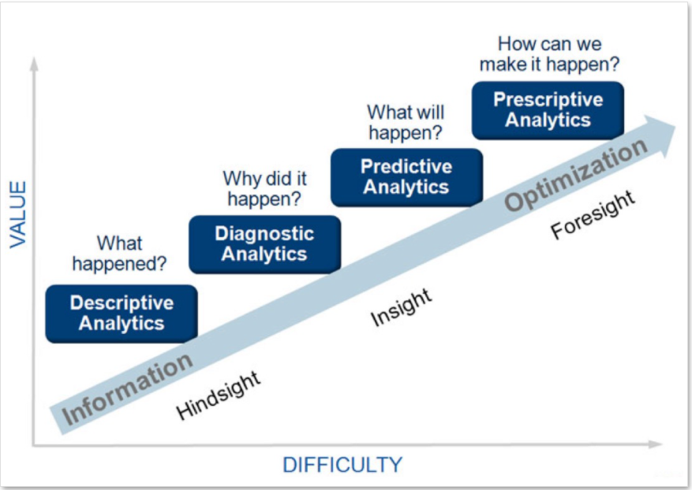
Questions that Data Analysis Answers

Slide 14
Types of Data Analysis: Refers to the questions that data analysis answers
Descriptive Analytics – What happened? – Observation/Describe event. It is the interpretation of historical data to better explain market developments.
Keywords: Historical Data, Observation, Describing Event.
Diagnostic Analytics – Why did it happen? – Explains the reason for the event. It enables the extraction of value from data by posing the right questions and conducting in-depth investigations into the problems.
Keywords: Data Extraction, Questions, investigation
Predictive Analytics – What will happen? –Predicts what will happen in the future. It uses data, statistical algorithms, and machine learning techniques to determine the JS of potential outcomes. The aim is to have the best assessment of what will happen in the future, rather than simply understanding what has happened.
Keywords: Correlation, ML, Statistical Algorithms, Future.
Prescriptive Analytics – How can we make it happen? –
Keywords: Change/Action/Solution/Causality/Manipulation/Decision Making.

Slide 15
Questions that Data Analysis Answers
Relationship between predictive and prescriptive analytics
Both are forward-looking tools used by business leaders.
Predictive analytics uses collected data to produce future outcomes, and prescriptive analytics takes that data and make decisions that cause future outcomes.
Inferential Analytics – What sampling method? aims to make inferences or predictions about a larger population based on sample data (random/stratified). Applies hypothesis testing, confidence intervals, and regression analysis. It helps generalize findings from a sample to a larger population.
Keywords: Generalization, Samples, Larger Population, Hypothesis Testing, Regression, Confidence Intervals.
Exploratory Analytics (EDA) – What visualization? – focuses on exploring and understanding the data without preconceived hypotheses. It involves visualizations, summary statistics, and data profiling techniques to uncover patterns, relationships, and interesting features.
Keywords: Visualization, hypotheses, further analysis.

Slide 16
LESSON II: DATA ANALYTICS TOOLS AND TECHNIQUES:
Database Concepts
Database architects determine what data needs to be stored and how to relate the tables of data to each other through relationships.
OLTP - Software that conducts many database transactions in real-time and over the internet at the same time – Online Transactional Processing.
OLAP - OLTP without affecting transactional systems. Allows a high volume of data to be analyzed more effectively.
Snowflake schema - features a single fact table joined to related dimension tables. The dimension tables might be tied to other dimension tables.
Star schema - Any related dimension tables join to a single fact table in a visual layout that looks like a star. It is one of the simplest schemas to use.
Non-relational database (NoSQL) addresses the need for web-based databases to handle large amounts of traffic and organizational data and is easier to scale and build for web applications. Can store structured and non-structured data. Uses various programming languages to retrieve and handle transactions.

Slide 17
LESSON II: Database Concepts Cont’d
NoSQL Categories:
Document-Oriented DB – XML or JSON.
Key-value stores - store each value with a key value.
Column-oriented databases - store data in columns rather than rows.
Graph stores store individual elements as nodes. Complex, connections are first-class elements.
Data Warehouse - aggregates data from multiple sources/segments of a business, without the data being necessarily related.
Data Lake - stores unstructured data that is classified and tagged with metadata.
Data Mart - A data warehouse that serves the needs of a specific business unit e.g finance, marketing, sale, etc.
Relational Database uses tables to store captured data. Tabular schema - rows and columns; two main design components - field name and the data type. Primary and foreign keys to establishing relationships. Leverage normalization, use SQL,
Relational Database Management System (RDBMS) - Software that maintains relational databases.
Tables in an RD have two main design components: the field name and the data type.

Slide 18
LESSON II: Database Concepts Cont’d
Compare and contrast different data types.
Quantitative Data: continuous, numeric, discrete.
Discrete values are fixed, taking certain values e.g. total items sold, count totals, individual items sold, currency, and prices.
Continuous – measurable values, can take any value, time series data.
Numeric characters – quantitative data -represented by specific number-based data types.
Qualitative data – e. g. ordinal, nominal.
Ordinal data - follows a natural order: low, middle, high income, etc.
Nominal Data - no assumed natural order e. g. safety features of a vehicle; model and make of vehicles, speed of a vehicle, dimensional data, textual data, etc.
Categorical data - qualitative data defined by specific qualities of the data, analysts cannot directly count, e.g. model and make of vehicles.
Parametric data assume a normal distribution of values or a “bell-shaped” curve.
Non-parametric - data that is falling outside of normal distribution.

Slide 19
Structured Data – numbered and labeled stored in an organized framework with columns and rows, e.g., SQL, databases, Excel, etc.
Semi-structured Data – loosely organized in categories using tags. e.g., Emails, CSV, XML, JSON doc., etc. .
Extensible Markup Language (XML) - the common language used in API web services.
JSON – JavaScript Object Notation, a lightweight format for storing and transporting data on networks. Also, an open standard file format, and data interchange format, use human-readable text to store and transmit data objects consisting of attribute–value pairs and array data types.
Unstructured Data – text heavy, information not organized in a clearly defined framework. Examples are images, videos, audio, and texts. Images are the most basic unstructured data. Text are nominal qualitative data like PDF, strings, alphanumeric, etc.
API stands for Application Programming Interface. An API is a software intermediary that allows two applications to talk to each other even though they are not related. In other words, an API is a messenger that delivers your request to the provider that you are requesting it from and then delivers the response back to you e.g., pay with PayPal, CashApp, etc. It allow developers to sync data between multiple platforms. APIs work by sharing data between applications, systems, and devices.

Slide 20
Explain data acquisition concepts
Sampling Method: stratified, and simple random.
Random – No grouping is necessary.
Stratified - Method of breaking down data into subgroups and randomly used within larger groups.
Web/Data Scraping: to pull information from the company website.
Extract, Transform, and Loading (ETL) - moves data between warehouses – from source warehouse to destination warehouse.
Extract, Load, Transform (ELT) - is a more modern model than ETL due to speed. ELT lets the data destination do the transformation, eliminating the need for data staging. Handles both structured and unstructured data, and any size of data.
Survey Q&A type: simple, multiple, and Likert choices.
Public databases - used to locate thousands of useable data sets online.
Delta Load - loads new data into a system and updates any existing data since the last load.
Extensible Markup Language (XML) - the common language used in API web services.
Extensible Markup Language (XML) - the common language used in API web services.

Slide 21
The Data Analytics Tools & Techiques
Course: – D204 – The Data Analytics Journey
Cohort Webinar
Series 3

Slide 22
Course Outline
S1. The Data Analytics Life Cycle
S2. DA Tools and Techniques
S3. Organizational Needs
S4. Ethical and Legal Issues
A5. Project Planning

Slide 23
Exams Pre-A 60 questions, 120 minutes OA-60 questions, 120 minutes
1. Competency 4030.2.1: The Data Analytics Life Cycle 30%
2. Competency 4030.2.4: Data Analytics Tools & Techniques 25%
3. Competency 4030.2.3: Organizational Needs 25%
4. Competency 4030.2.2: Project Planning 20%

Slide 24
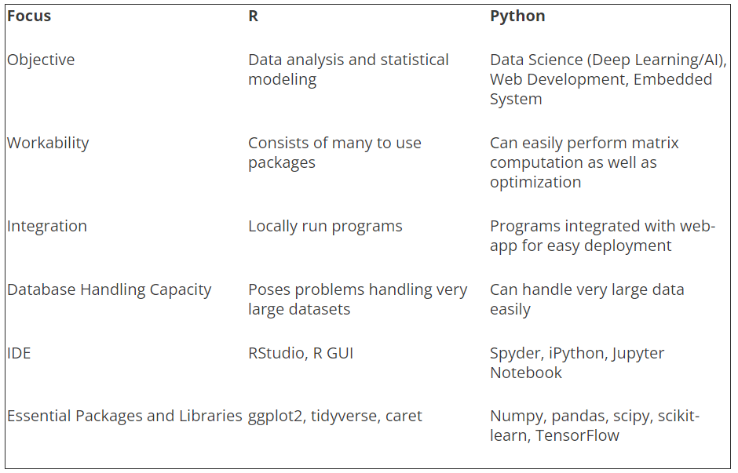
LESSON II: DATA ANALYTICS TOOLS AND TECHNIQUES
Programming Tools: Python and R
PYTHON VS R
PYTHON | R
Used by programmers that want to delve into data analysis or apply statistical techniques, and by developers and programmers that turn to data science. | Used primarily in academics and research and is great for exploratory data analysis. In recent years, enterprise usage has rapidly expanded.
A production-ready language with capacity to be a single tool that integrates with every part of your workflow! | Used by statisticians, engineers, and scientists without computer programming skills. It’s popular in academia, finance, pharmaceuticals, media, and marketing.
Easier for people with software engineering background. | Easier for people with no coding experience.
Coding and debugging is easy because of the simple syntax. | Statistical models can be written with only a few lines.
The indentation of code affects its meaning. | The indentation of code does not affect its meaning
Any piece of functionality is always written the same way with Python. | The same piece of functionality can be written in several ways.

Slide 25
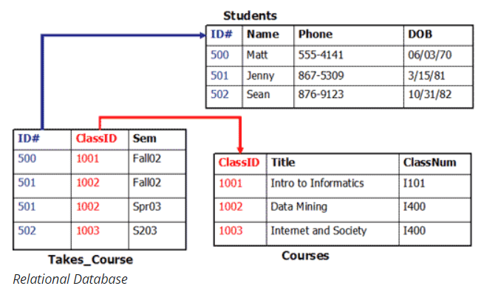
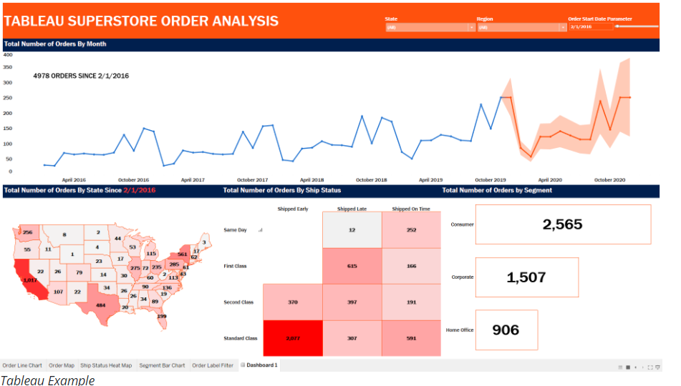
LESSON II: DATA ANALYTICS TOOLS AND TECHNIQUES
Other Tools: SQL and Tableau
Structural Query Language (SQL) is a language that allows an analyst to interface with relational databases. A relational database is a collection of data items with pre-defined relationships between them. These items are organized as a set of tables with columns and rows. Scripting Language, has interpreter, no compiler.
Tableau can help anyone see and understand their data via visual dashboards. An analyst can connect to almost any database, drag-and-drop to create visualizations, and share their creations with other stakeholders easily. It allows stakeholders an opportunity to interact with the data via filters, parameters, and so on.

Slide 26
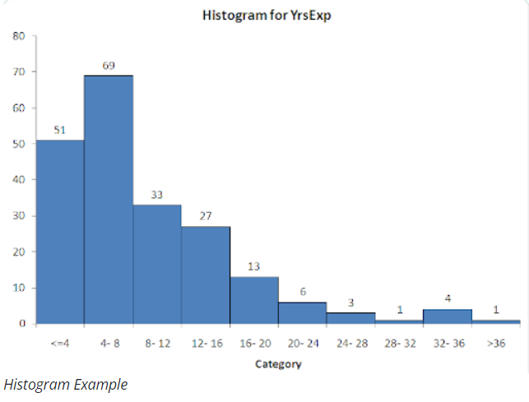
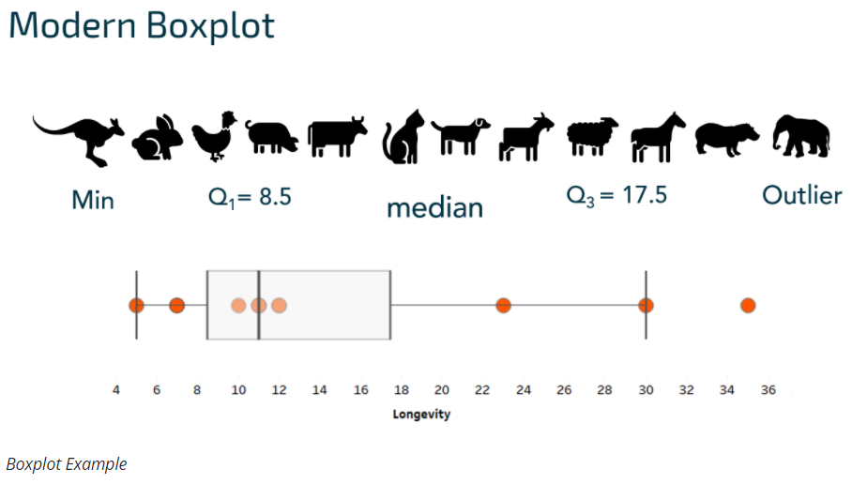
LESSON II: DATA ANALYTICS TOOLS AND TECHNIQUES
Graphs: Histogram, Boxplot, Heatmap, and Scatterplot.
Histograms show numerical data in “groups” or bins that allow bars to represent frequencies. Helps detect Outliers.
A boxplot provides a concise summary of the quartiles of numerical data (i.e., cut points that divide the data into 25% percentile segments). This graph is also convenient for detecting outliers and skewness.

Slide 27

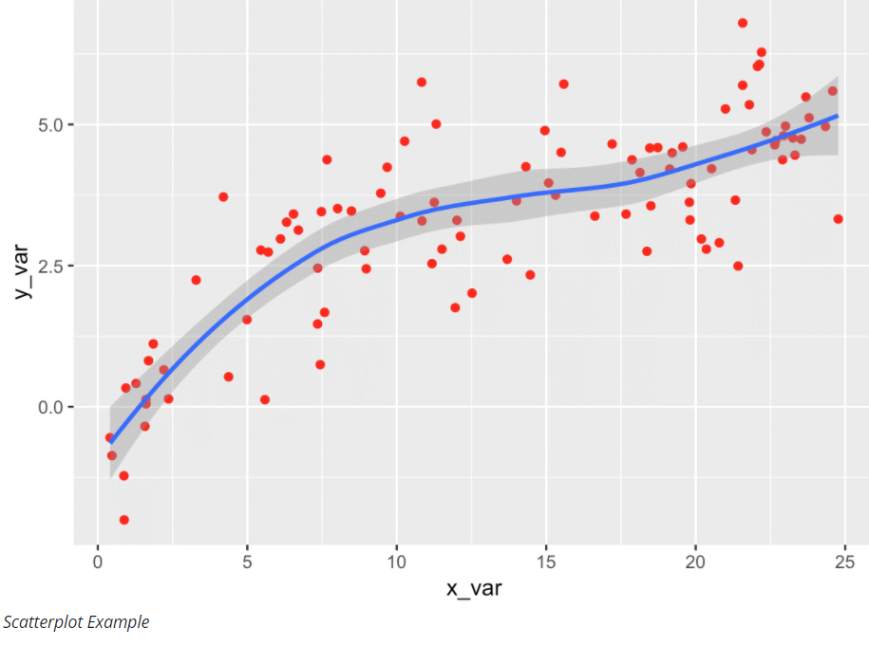
LESSON II: DATA ANALYTICS TOOLS AND TECHNIQUES
Graphs: Histogram, Boxplot, Heatmap, and Scatterplot.
A heatmap is a colorful graph that can visually show frequency or interaction using a range of colors. Red & Orange for higher data values. Blue & Green for lower data values.
A scatterplot is a two-dimensional graph that is great to visualize correlations or relationships. Each dot on the scatterplot represents an outcome for two numerical variables of interest.

Slide 28
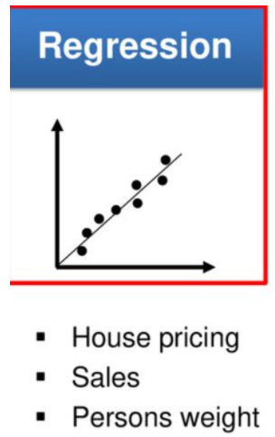
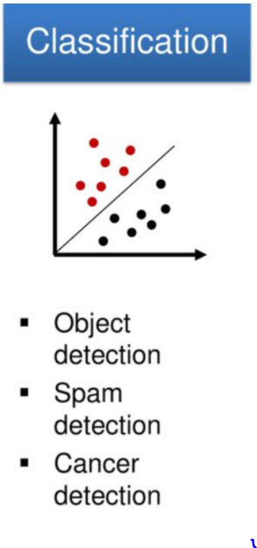
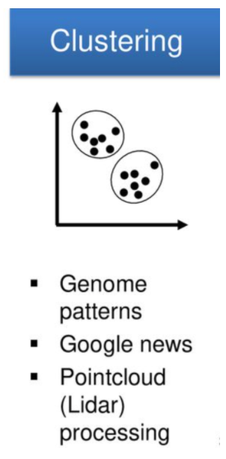
LESSON II: DATA ANALYTICS TOOLS AND TECHNIQUES
Techniques: Classification, Clustering, PCA.
Clustering – groupings are unknown, unlabled, and unsupervised, and the analyst wishes to determine if the objects belong to any group.
Regression is a technique that allows us to predict an outcome based on a set of predictor variables. It is like providing output given a set of inputs.
Classification: A technique in which the analyst wants to assign an item to a specific category based on various conditions. The model finds the location of the item, compare this item to items close by, then assign them to a group. Groups are known, labled, supervised. Also used for object detection, spam detection, cancer detection, etc. Methods: K Nearest Neighbors

Slide 29
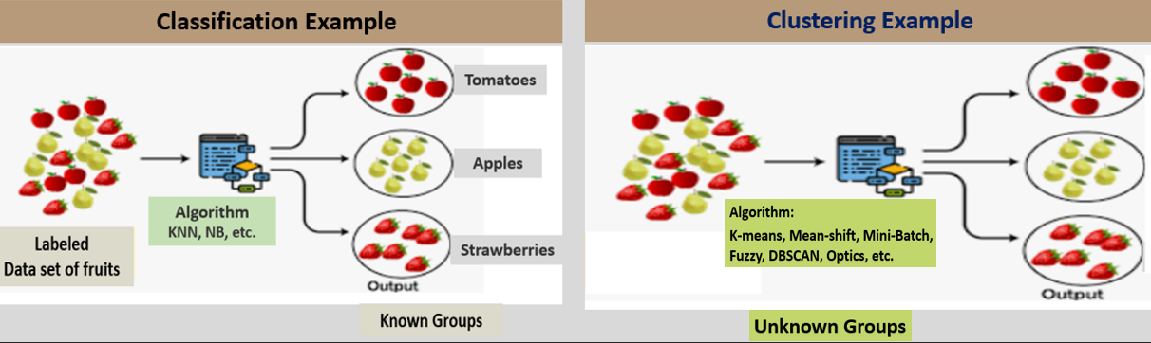
Classification/Clustering Example
Example 1: For classification, the groups are known or labelled. The general approach in classification is locate, compare, and assign. Classification is a supervised learning. Clustering is an unsupervised learning, meaning the algorithm is not guided or provided any supervision and the dataset is unlabeled. See examples below.
Example 2: You are given a medical data to find out the conditions of the patients. You have no idea what type of conditions (cancer, diabetes, asthma, etc.) exist in the data and how many of those conditions. Your job now is to group the patients based on their conditions and in the process, you will figure out how many of those conditions exist in the data set. What you are doing is called Clustering.
Supervised Machine Learning
Unsupervised Machine Learning

Slide 30
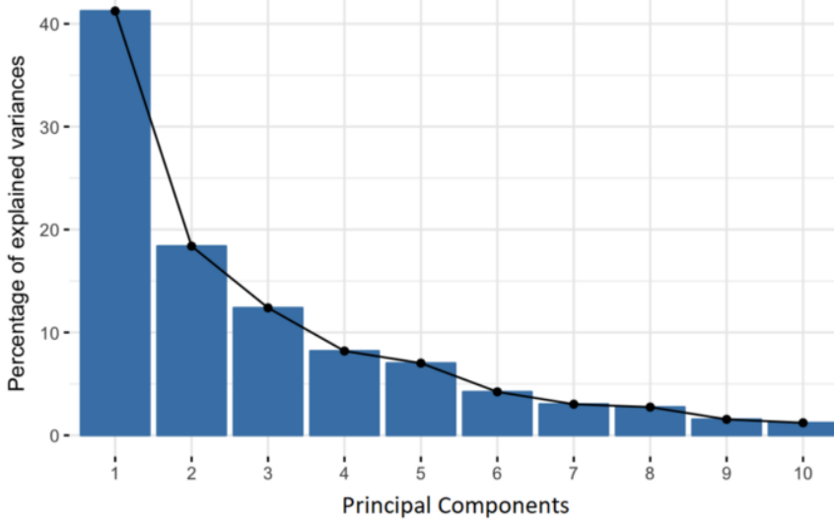
Principle Component Analysis (PCA)
Principal Component Analysis (PCA).
In PCA, an analyst attempts to find out if the variables themselves group in any meaningful way.
PCA is a non-parametric technique to reduce the dimensionality of large data sets, by transforming a large set of variables into a smaller one that still contains most of the information in the large set.
It provides the ability to visualize the data as separate classes, groups, or clusters.
The elbow method and Kaiser methods can be used in implementing the PCA.
Assumption of PCA-
Linearity in the data set. The features exhibit relationships among themselves.
Choose Principal Components with higher variance.
How to do PCA:
Standardize the range of continuous initial variables.
Compute the covariance matrix to identify correlations.
Compute the eigenvectors and eigenvalues of the covariance matrix to identify the PCs.
Create a feature vector to decide which principal components to keep and recast the data along PC axes.

Slide 31
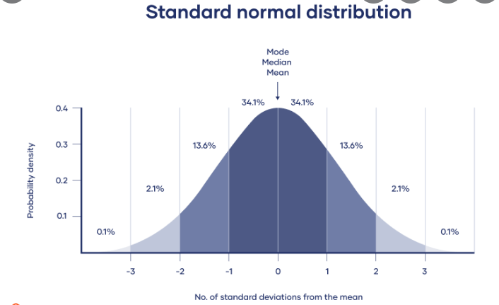
Normal Distribution (Bell-Shaped), a symmetrical curve centered around the mean. It’s data falls to the empirical rule that indicates the percentage of the data set that falls within (plus or minus) 1, 2 and 3 standard deviations of the mean. It is not skewed either. This is parametric.
The Bell curve with a long tail end. It is a bell curve with a long tail distribution. The long tail is the portion of the distribution having many occurrences far from the central part of the distribution (skewed). In sales, it may mean more people buying individualized niche products. This non-parametric.

Slide 32
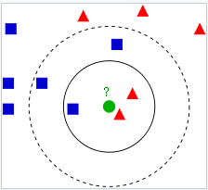
K-Nearest Neighbors – KNN
K-NN is a non-parametric classification method. The basic idea of k-NN is to predict the label of any data point by looking at the ‘k’ closest labeled data point, for example, 5 closest labeled data points, and getting them to vote on what the unlabeled point should have. The new data point is then assigned the label of the majority of the ‘k’ closest points. k-NN uses distance, and the standard Euclidean distance is the most common and default choice. See the example below:
In the diagram, the test sample (green dot) should be classified either as blue squares or red triangles.
If k = 3 (solid line circle), it is assigned to the red triangles because there are 2 triangles and only 1 square inside the inner circle.
If k = 5 (dashed line circle), it is assigned to the blue squares (3 squares vs. 2 triangles inside the outer circle).
Note: Data labeling helps tell the difference between two or more objects or data points, e.g., a person, car, a house, a street, etc., by labeling the key features of those objects or data points and looking for similarities between them.

Slide 33
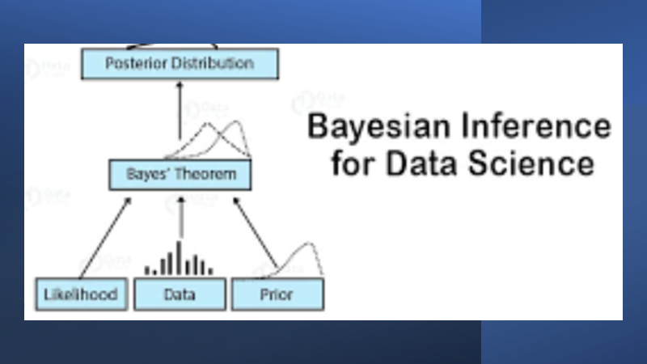
Baye’s Theorem and Naïve Bayes
Baye’s Theorem and Naïve Bayes
Baye’s theorem – describes the probability of an event, based on prior knowledge of conditions that might be related to the event.
For two events, A and B, Bayes' theorem allows you to figure out p(A|B) the probability that event A happened, given that B conditions.
In data science, it means the probability of observing various data, given the hypotheses, and the observed data.
It gives you the after-the-data probability of a hypothesis as a function of the likelihood of the data, the probability of getting the data you found.
This conditional probability is known as a hypothesis. This hypothesis is calculated through previous evidence or knowledge.

Slide 34
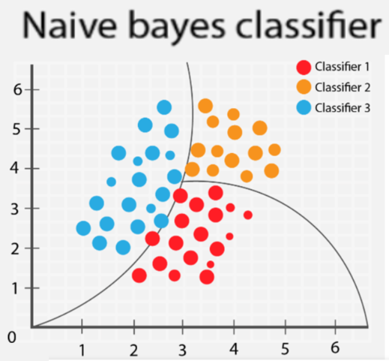
Naïve Bayes
Naïve Bayes was founded by Thomas Bayes as an algorithm that applies Baye’s theorem to estimate the conditional probability of an outcome.
The Naïve Bayes classifier classification method is more suitable for large datasets, and all the categorical parameters are independent.
A dataset of 10,000 observations and 50 variables is large enough for NB. When the calibration sample sizes increase, Naïve Bayes classifiers will outperform other highly advanced classification methods in terms of classification accuracy. (Rudner, 2016; Vomlel, 2004).
Naïve Bayes classification assumes the variables are independent; in other words, a specific feature in a class is unconnected to the occurrence of other elements. (Draper & Smith, 1998).

Slide 35
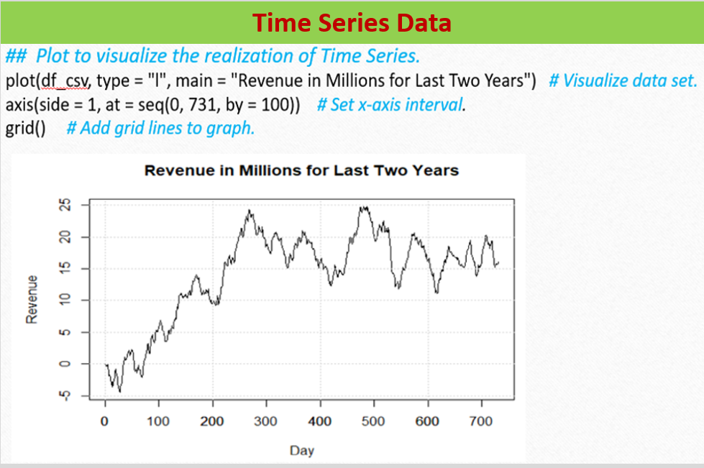
TM Data is data collected over time. TM is a statistical tool that deals with a sequence of data in chronological order. TM components are a trend, seasonality, and residual. Time Series Examples include the daily log returns on stock, monthly values of the consumer price index, or CPI, which is a measure of the national inflation rate.

Slide 36
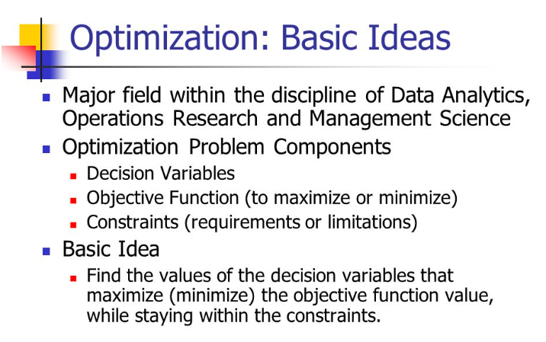
Optimization Analysis
An Optimization Analysis is finding the best value for one or more target variables given certain constraints.
It shows what value a variable should have, given certain conditions or restraints.
In business, it means minimizing cost and maximizing revenue.
In process engineering it means optimizing the business processes by minimizing waste and maximizing efficiency.

Slide 37

Organizational Needs/Ethics/Law
Course: – D204 – The Data Analytics Journey
Cohort Webinar Series 4

Slide 38
Course Outline
S1. The Data Analytics Life Cycle
S2. DA Tools and Techniques
S3. Organizational Needs
S4. Ethical and Legal Issues
A5. Project Planning

Slide 39
Exams Pre-A 60 questions, 120 minutes OA-60 questions, 120 minutes
1. Competency 4030.2.1: The Data Analytics Life Cycle 30%
2. Competency 4030.2.4: Data Analytics Tools & Techniques 25%
3. Competency 4030.2.3: Organizational Needs 25%
4. Competency 4030.2.2: Project Planning 20%

Slide 40
Learning Outcomes
This lesson is about the needs of the organization and the requirements of the project as discussed in the discovery phase of the Life Cycle. The discovery phase informs, supports, and sets the groundwork for successful data analytics projects.
Data analysis does not happen in a vacuum. It costs money and takes time to complete the work requirements.
Identify the decisions necessary to initiate a data analytics project.
Delineate clear outcomes and undefined outcomes of potential data analytics projects.
Define clear metrics, deliverables, and value that a data analytics project will provide to an organization.
Compare data types and sources that organizations often have available.
Define specific research questions and hypotheses based on organizational needs and available data.
Match available data types to the possible analytical approaches they enable.

Slide 41
Key Stakeholders
A stakeholder refers to an individual or group that has an interest or power in any decision or activity of an organization or the project. e.g., managers, executives, sponsors, employees, third parties, vendors, suppliers, contractors, financial institutions, government regulatory agencies, foreign governments, etc.
A Project Sponsor is a stakeholder responsible for identifying a project topic/scope that is aligned with the strengths of the data analytics project. Provides resources (data, staff, materials, etc.).
Data Analytics Program Manager is a stakeholder who provides direction and builds the team, make hiring decisions, oversees the work, and ensuring that the project is delivered successfully to meet the requirements for time, cost, scope/quality (known as the “iron triangle” or “triple constraint.”)
Project Manager vs Program Manager

Slide 42
Stakeholder Register
has information about the project stakeholders
Project Name: Data Analytic Project |  |  |  |  |  | Date: 02/27/2021
Name | Position | Location | Role | Contact | Power / Influence | Interest | Internal/ External | Comm. Plan | Comm. Frequency
Joe Dery | VP & Dean | HDQ1 4S4A54 SLC | Project Executive | 817-931-6836 | Very High | High | Internal | Email, F2F, Teams, WebEx | Weekly & monthly
Eric Lagally | Academic Director | HDQ14S4A04 SLC | Project Sponsor | 817- 967- 2334 | High | Very Low | Internal | Email, I:1, Teams, WebEx | Weekly
Summer Ball | Manager, PM MSDA | HDQ1-4W3D-45 SLC | Project Owner |  | High | High | Internal | Email, Teams | As needed
Kesselly Kamara | CI, MSDA | HDQ13A-93 | Analyst | 817-931-6738 | Low | High | Internal | Emails, phones, F2F, Team, SharePoint | As needed
Festus Elleh | CI, MSDA | HDQ15D-61 | PM | 214-214-214 | Low | Very High | Internal | Emails, F2F, phones, Teams, SharePoint | Daily
Keiona Middleton | Sr. CI, Software | HDQ15A-04 | SME | 817-931-2230 | Low | Low | Internal | Email, Teams, WebEx | As needed
Arunima Choudhury, CI Data Science | CI, S | HDQ1-4W1A-53 | SME | 817-931-9342 | Very Low | Low | Internal | Email, Teams, WebEx, | As needed

Slide 43


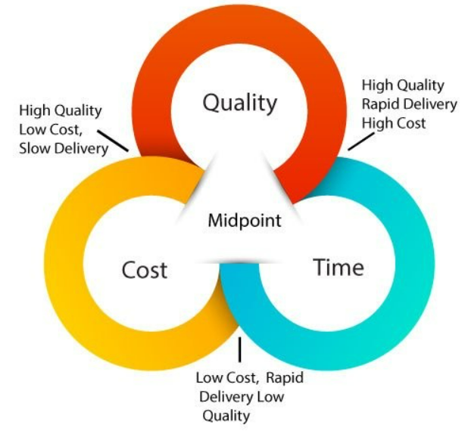

THE IRON TRIANGLE
The iron triangle shows in graphical form project constraints (Time, Cost, Scope/Quality):
Other Names:
Golden Triangle
Triple Constraints
Trinity
Quality is a central them which is at the midpoint. If you break Iron Triangle by making a change to one constraint, other two needs to be adjusted accordingly otherwise quality will suffer.
Some variations use quality interchangeably with scope.

Slide 44
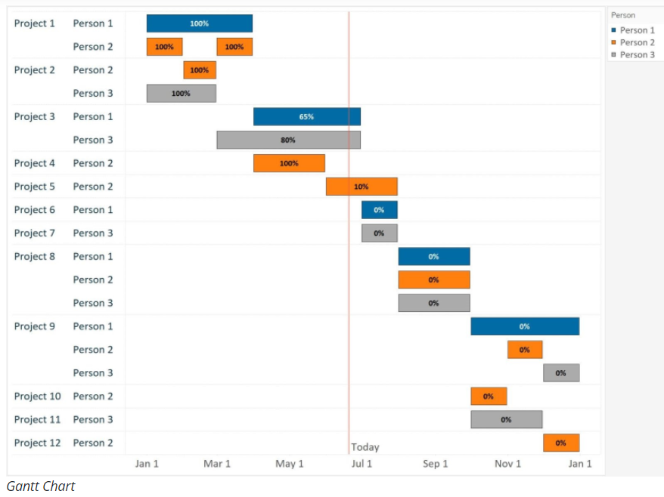
Gantt Chart
The Gantt chart is a tool used in project management to schedule and estimate tasks and task durations. The Gantt chart includes a task list and a calendar that shows project duration. Henry Gantt, an American engineer developed the Gantt Chart. The United States Navy first used the Gantt chart for their ship construction project during the First World War. See the example of a Gantt Chart.

Slide 45
Ethics, Regulation, and Law
Learning Objectives
Summarize the legal frameworks governing data,
Examine fairness issues raised by data analytics projects,
Examine justice issues raised by data analytics projects, and
Examine issues of human and computer agency.
A data analyst must deal with ethical issues through out the data analytics project.
Involves doing the right thing with data, considering the human impact from all sides, and making decisions based on your brand values.
The American Statistical Association lists the following ethical guidelines for data analytics:
Uses methodology and data that are relevant and appropriate.
No favoritism or prejudice.
Produce valid, interpretable, and reproducible results.
Do not knowingly accept work for which you are not sufficiently qualified.
Be honest with the client about any limitation of expertise and consults other statisticians when necessary or in doubt.
Ethical Issues

Slide 46
IRAC
Is a document to determine if any privacy or ethical areas have been violated.
IRAC stands for:
Issue: State the legal issue(s) to be discussed.
Rule: State the relevant statutes and case law.
Application: Apply the relevant rules to the facts that created the issue.
Conclusion: State the most likely conclusions using the logic of the application section and whether there has been a violation.

Slide 47
Data Privacy
Involves collecting, using, and storing data about people, in line with the expectations of those people, your customers, regulations and laws.
Privacy Regulators and Legislations.
Europe - General Data Protection Regulation (GDPR). Used by European Union to regulate privacy issues. It is generally more prescriptive and detailed.
United States. - It’s vital that policymakers and regulators develop a deeper understanding about what they wish to regulate at the U.S. State and Federal level, and the same is important for policymakers in countries outside the U.S. Given the profound shifts in our global, digital, data-centric economy and the opportunities it offers to people and societies. HIPAA - The Health Insurance Portability and Accountability Act of 1996 (HIPAA).
The FERPA - Family Educational Rights and Privacy Act of 1974.
Policy makers must consider:
What harms are they trying to protect people from?
What rights do they want to guarantee?
What problems are they trying to solve?
What are the privacy outcomes they hope to achieve for their citizens?

Slide 48
Thank You
Quizlet 1: https://quizlet.com/585467577/my-d204-wgu-study-set-flash-cards/https://quizlet.com/585467577/test
Quizlet 2: https://quizlet.com/585467577/my-d204-wgu-study-set-flash-cards/
Cohort Information
D204 Host: D204 Host Link
D204 Guest: D204 Guest Link
Student Link: See link at the homepage
Session number: 120 126 7825
Password: d204

Slide 49
Project Planning/Teamwork & Collaboration
Course: – D204 – The Data Analytics Journey
Cohort Webinar Series 5

Slide 50
Course Outline
S1. The Data Analytics Life Cycle
S2. DA Tools and Techniques
S3. Organizational Needs
S4. Ethical and Legal Issues
A5. Project Planning

Slide 51
Exams Pre-A 60 questions, 120 minutes OA-60 questions, 120 minutes
1. Competency 4030.2.1: The Data Analytics Life Cycle 30%
2. Competency 4030.2.4: Data Analytics Tools & Techniques 25%
3. Competency 4030.2.3: Organizational Needs 25%
4. Competency 4030.2.2: Project Planning 20%

Slide 52
Roles on a Data Analytics Project
Data analysts (DAs) do the following:
Often work on unique, one-time projects.
Conduct full lifecycle analysis of the project to include requirements, activities and design.
Develop analysis and reporting capabilities; monitor performance and provide quality control plans to identify improvements.
Write codes in programming languages like Python and R.
Work alongside teams within the business or the management team to establish business needs.(Rose, 2016).

Slide 53
Program managers provide direction and build the team, make hiring decisions, oversee the work, and ensuring that the project is delivered successfully to meet the requirements for time, cost, scope, and quality.
The database administrator maintains data on the IT infrastructure.
The project manager on a data science team communicates insights from the data analytics team and provides ideas of ways to act on those insights. The PM democratizes the data, share the results, and enforce organizational learning.
Engineer: Developers, architects
Machine Learning Specialists: work in computer science, AI
Researcher: domain specific research, physics and genetics are common, more statistical expertise
Managers: manage DS projects, frame biz questions and solution, speak data.
(Rose, 2016, LinkedIn Video).

Slide 54
Define Roles of Partners and Stakeholders in Data Analytics Projects.
Entrepreneur: DB startups, biz acumen, creativity and planning
The Unicorn: rock star, ninja, very rare.
A stakeholder make decisions on the project. Provide direction and input on the project.
Partners are the organizations responsible for carrying out specific project activities in the manner and scope indicated in the application form.
Project Owner are stakeholders like customer, client, or internal department or group for whom a project is performed and who will, in effect own, the completed project deliverables.
Project Provider are stakeholders like the contractor or internal group who has the responsibility for planning, executing, controlling, and completing the project work.
Project Sponsor has the primary vision for a data analytics project and brings resources to complete it.
(Rose, 2016, LinkedIn Video).

Slide 55
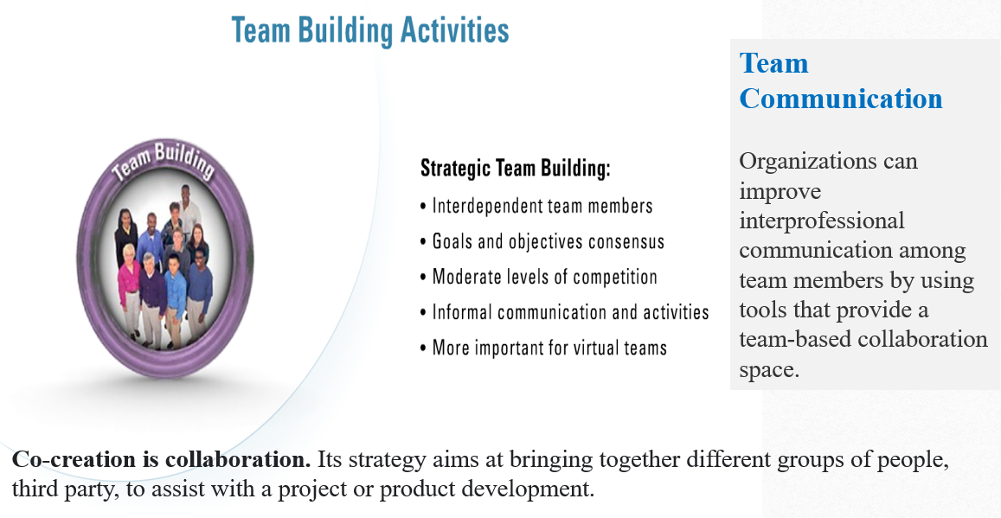
Teamwork – Co-creation - Collaboration

Slide 56
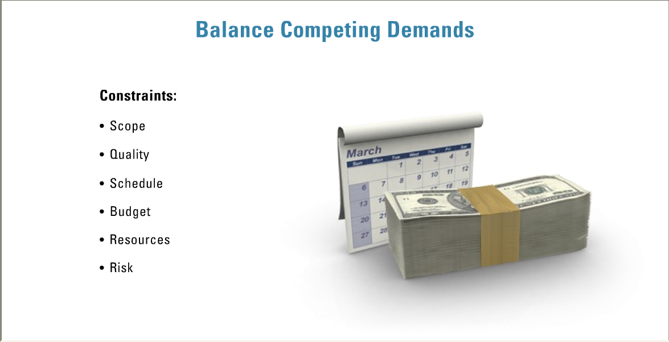
Challenges of Balancing Resources, Timelines,
and Quality in Data Analytics Projects.
Scope is the sum of the products, services, and results to be provided as a project.
.02
Quality simply refers to the project's conformance to scope or set requirement (Hribar et al., 2009; Sun, 2010). “fitness for use.”
Schedule - detailed specification of the individual actions, activities, and steps for project implementation (Isken et al., 2011).
Budget is the aggregate cost of the project.
Resources: man, material, money, and machine used to accomplish a task.
Risk: an uncertain event or condition that, if it occurs, has an effect on at least one project objective (PMI, 2017).

Slide 57
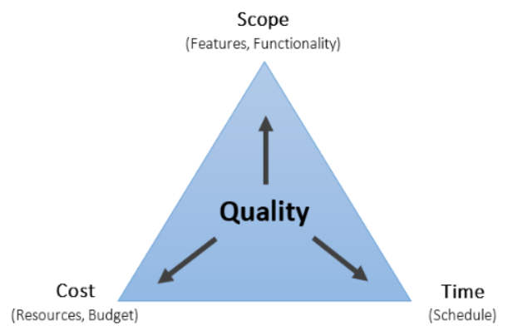
Trade-Offs
Quality could be impacted for any changes on the triangle
If time is of essence: Spend more (trade off Cost) to save time e. g. expand the team with experienced staff, add more resources, etc.
If cost is of essence: Reduce resources on project, higher technicians instead of engineers to save cost, no overtime, no resource overallocation, etc.
If scope is of essence: Scope reduction (reduce work packages), avoid scope creep, adopt descoping, etc., but be careful with quality. Changing scope is the last resort.

Slide 58
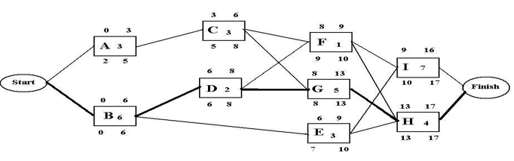
Explain Critical Path and its Relation to Project Timelines.
The Critical Path is the longest path of dependent activities on a project or the minimum amount of time necessary to complete all project work.
The Critical Path Method (CPM) was developed in 1950 as a technique used to manage project schedule (Stretton, 2007).
Network Diagram
Shows a sequence of activities connected by logical relationships in a project schedule.
Delay of any work activity on the critical path will delay completion of the project.
A concept called slack or float recognizes that some work activities not on the critical path may be delayed without delaying completion of the project.

Slide 59
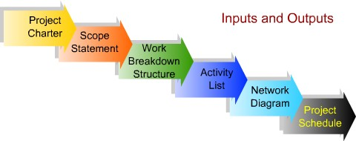
Estimate Timelines for Data Analytics Project Deliverables
STEPS TO BUILDING THE PROJECT SCHEDULE
After defining a project scope, creating a supporting WBS, and identifying the work activities required to achieve the scope requirements. Next is to create a project schedule
“If you estimate correctly, you will deliver a project on time and within budget; get it wrong and you
could end up over budget, with an unhappy client and a burned-out team.”
Ben Harden, PMP (2010)

Slide 60
AON Network Diagram
Practice Project Network Problem:
The following data were obtained from an in-house IS project:
a. Construct an AON network for the project.
b. Calculate the scheduled completion time and identify the critical path.
c. What is the slack time (float) for activities A, D, E, and F?

Slide 61
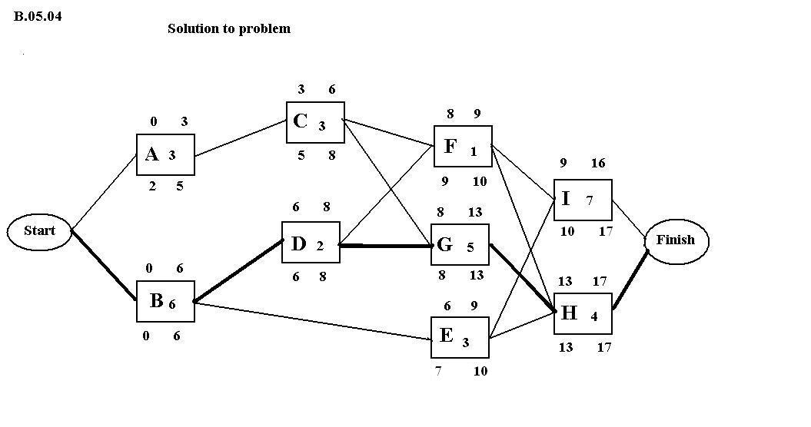
Answer:
Construct an AON network for the project.
Check answer:
Completion time = 17 days

Slide 62
b. Calculate the scheduled completion time and identify the critical path. List ALL the paths in your network Sum the duration of each path Your project duration is the length of the longest path Your critical path is the longest path as well Completion time = 17 days
Critical Path = B-D-G-H
What is the slack time (float) for activities A, D, E, and F? From the Network Diagram, Slack = LST – EST

Slide 63
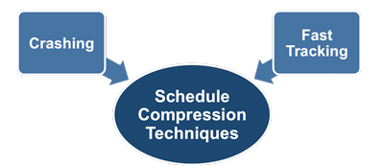
How to speed up your project plan
(Croft, 2020: LinkedIn Video)
Crashing. Adding more resources like labor and equipment to shorten tasks on the critical path at greater cost to cover the expense of the added resources. Remember, when crashing a project, to focus only on critical activities or near-critical path activities and remember that the project’s cost will always rise when crashing a project.
Fast Tracking. Arranging tasks on the critical path in parallel form so that they can be performed at the same time, or concurrently rather than sequentially. Activities on the critical path are connected by predecessors.
Scope Reduction. Relaxing the technical requirements for tasks on the critical path or reducing the project scope such as providing less functionality in a product or accepting less stringent quality standards.

Slide 64
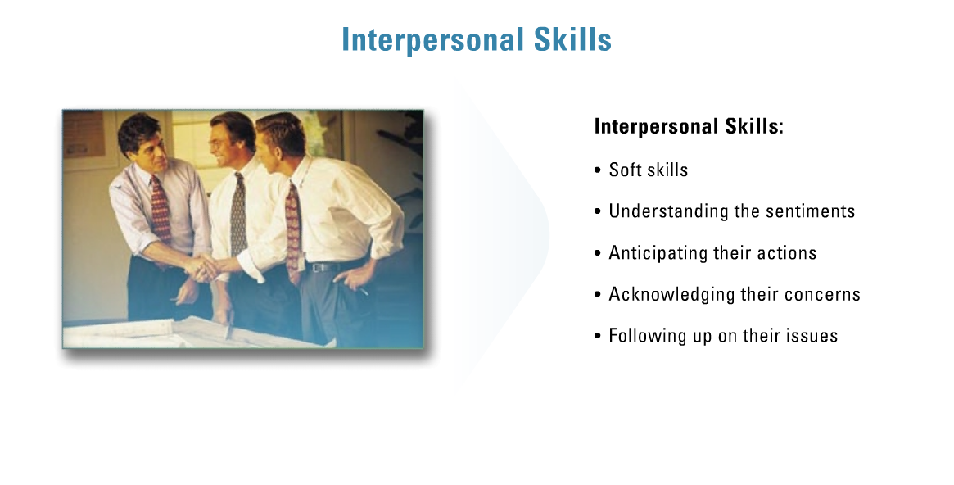
Effective Interpersonal Communication.
“Employers in today’s corporate World demand cross-functional collaborative teams to build synergy and optimization..” - Dr. Elleh, My 2 Cents Please!
Two important things in this lesson: Communication and Teamwork
Communication: Reporting and presenting data analytics projects. A "good" data analyst can perform analyses; a "great" data analyst can communicate the results effectively.
(Lesson 4, p6).

Slide 65
Persuasion
Persuasion involves several other common soft skills, including:
Communication: You’ve learned the language of analytics, but others in your organization do not. You need to speak in the language of the organization when reporting on your project to avoid any disconnect or confusion.
Emotional intelligence: Ability to identify and manage one's own emotions, as well as the emotions of others. You need to be in control of your emotions. Self-awareness, empathy, motivation and justice can help you handle EI.
Active listening: It is one proven way that you can show empathy.
Logic and reasoning: make decisions based on facts and figures. Draw conclusions based on evidence and sound reasoning.
Negotiation: Negotiate to avoid conflict.
Interpersonal skills: Good attitude, positive interaction with others, listen and follow directives.

Slide 66
Next Webinar
will be
Next Month:
Quizlet 1: https://quizlet.com/585467577/my-d204-wgu-study-set-flash-cards/https://quizlet.com/585467577/test
Quizlet 2: https://quizlet.com/585467577/my-d204-wgu-study-set-flash-cards/
Cohort Information
D204 Host: D204 Host Link
D204 Guest: D204 Guest Link
Student Link: See link at the homepage
Session number: 120 126 7825
Password: d204

Slide 67


